Slide 1

UNCTAD 11TH TRANCHE OF THE DEVELOPMENT ACCOUNT NATIONAL WORKSHOP
Sustainability Reporting For SMEs on Contribution
Towards Implementation Of The Sustainable Development Goals
Elena Botvina
Division of Investment & Enterprise
UNCTAD

Slide 2
Content
Development Account 11th Tranche Project Background
Meeting Objective
Global Trends in Sustainability Reporting
Measuring Impact of the Private Sector in Attaining SDGs (Indicator 12.6.1)
GCI Framework and Practical implementation

Slide 3

Development Account 11th Tranche
Project Background
Strengthening the capacities of Governments to measure and monitor the private sector contribution to the 2030 Agenda for Sustainable Development, in particular on target 12.6 Encourage companies, especially large and transnational companies, to adopt sustainable practices and to integrate sustainability information into their reporting cycle.
SDG indicator
12.6.1 Number of companies publishing sustainability reports.
Notes:
The two target regions are Africa and Latin America.

Slide 4
Project Beneficiary countries
AFRICA | LATIN AMERICA
Kenya | Colombia
South Africa | Guatemala

Slide 5
Current Progress of the DA Project Phase
Phase 1
Development of a sustainability and SDG reporting assessment tool
Phase 2
Developing and implementing project activities in beneficiary countries
Phase 3
Regional collaboration and experience sharing of the lessons learned from the beneficiary countries
Status: Finalization
Current Phase
Notes:
Phase 1: The development of a sustainability and SDG reporting assessment tool and roll out at the country level
During the first phase of the project, the ADT was revised n order to incorporate new developments in the area of ESG reporting, reflecting the role of enterprise sustainability in the context of the 2030 Agenda for Sustainable Development and its SDGs. Expert meetings took place and distance trainings are being developed and will be delivered to relevant stakeholders in beneficiary countries as a preparation for the roll-out of activities and tools in the selected beneficiary countries.
The roll-out at the country level will include a kick-off multi-stakeholder meeting to launch the project implementation process, carrying out a national assessment of the sustainability and SDG reporting structure in each beneficiary country and the organization of a three-day national workshop to validate findings from the surveys and the implementation of the ADT with a focus on SDG reporting.
Phase 2: Development and implementation of action plans in beneficiary countries
In the second phase of the project UNCTAD will support the national stakeholders in developing an action plan for high quality sustainability and SDG reporting and will provide advice on the implementation of priority actions. Finally, in close consultation with national authorities and other stakeholders in the beneficiary countries, UNCTAD will deliver one capacity building activity in each of the beneficiary countries to assist companies in pilot-testing the reporting requirements arising from the endorsed national action plan.
Phase 3: Regional collaboration and experience sharing of the lessons learned from the beneficiary countries
In the last phase, UNCTAD will deliver two regional workshops (one in Africa and one in Latin America) to share lessons learned from the implementation of the project and the use of UNCTAD’s tools, as well as the development of national action plans for enabling sustainability and SDG reporting frameworks. In addition, an expert meeting will be organized bringing together stakeholders involved in the implementation of project at the national level, as well as other stakeholders who participated in the development of the GCI. The last activity consists on enriching and updating the tools used based on the feedback from practical implementation and also in disseminating relevant information about the project.

Slide 6
Meeting Objective
To deliver a training for the key experts and stakeholders in the area of sustainability/SDG reporting as a set of capacity building activities in South Africa with a view to:
Present the “Guidance on core indicators for entity reporting on contribution towards implementation of Sustainability Development Goals" (GCI);
Inform on the findings of the conducted case studies in South Africa and other countries;
Share an update on the international trends and developments in this area.

Slide 7
INTERNATIONAL TRENDS
Sustainability Reporting

Slide 8
Key international developments in this area of sustainability reporting
During 2020 and 2021, a series of key international developments in this area took place:
In September 2020, an open letter was sent by CDP, CDSB, GRI, IIRC and SASB to the International Organization of Securities Commissions (IOSCO), in which they express their support to the foundation of a global architecture for sustainability disclosures that enables consistent reporting of information that is relevant for enterprise value creation.
Consultation paper on Sustainability Reporting issued by the IFRS Foundation proposed the creation of a Global Sustainability Standards Board. Trustees welcomed the collaboration with IOSCO. They aim to make a final determination about a new board before United Nations COP26 conference that takes place in November 2021.

Slide 9
Key international developments in this area of sustainability reporting
In June 2020 the European Commission issued a request to undertake preparatory work for possible EU non-financial reporting standards in a revised Non-Financial Reporting Directive.
In March 2021 the European Financial Reporting Advisory Group (EFRAG) set out recommendations on the development of EU sustainability reporting standards.
World Economic Forum released a set of universal environmental, social and governance (ESG) metrics and disclosures to promote reporting by companies on non-financial issues.
Value Reporting Foundation merges the SASB and IIRC into an international organization that maintains the Integrated Reporting Framework, advocates integrated thinking, and sets sustainability disclosure standards for enterprise value creation.

Slide 10
UNCTAD Guidance
Core Indicators For Entity Reporting on Contribution Towards Implementation of SDGs

Slide 11

Introduction: rationale and objective to SDG Reporting
In 2015, Member States of the United Nations adopted the 2030 Agenda for Sustainable Development
Relevant data on companies’ contribution towards SGDs is critical for assessing the progress of SDG implementation

Slide 12

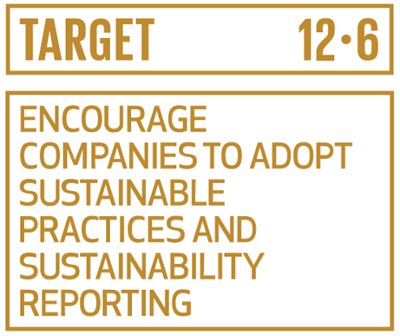
SDG 12: Responsible Consumption & Production
SDG 12 Sustainable Consumption and Production in its Target 12.6 explicitly encourages companies, especially large and transnational companies, to adopt sustainable practices and to integrate sustainability information into their reporting cycles.
SDG indicator 12.6.1
Number of companies publishing sustainability reports.
Notes:
The two target regions are Africa and Latin America.
12

Slide 13
SDG 12.6.1: Methodological Development
Target 12.6 Encourage companies to adopt sustainable practices and to integrate sustainability information into their reporting cycle.
Indicator 12.6.1 Number of companies publishing sustainability reports.
The Indicator custodians UN Environment and UNCTAD were tasked to develop the measurement methodology for the indicator, as well as overseeing the data collection and reporting process on 12.6.1 up to 2030.
The development of the metadata guidance for this indicators takes place under the auspices of the Inter-agency and Expert Group on Sustainable Development Goal Indicators (IAEG-SDGs). In September 2019 the SDG 12.6.1 was reclassified to Tier II indicator, which means that the internationally recognized methodology has been approved for the further data collection started from 2020.
The data collection mechanism has been developed in cooperation with the Big Data not-for-profit organization. Pilot testing of data collection was conducted in 2H 2020 and submitted to the SDG Global Database in Q1 2021.
Notes:
Indicator 12.6.1 requires data on the number of companies publishing sustainability reports.
The project builds on the existing close cooperation between UNCTAD and UN Environment as co-custodians within the UN System of SDG indicator 12.6.1 Number of companies publishing sustainability reports.
In this context, the two entities aim at enabling the development of enterprise sustainability reporting mechanisms encompassing economic, environmental, social and institutional indicators that are aligned with the SDGs. At the heart of these mechanisms is the integration of financial and non-financial information as part of companies’ reporting cycles.

Slide 14
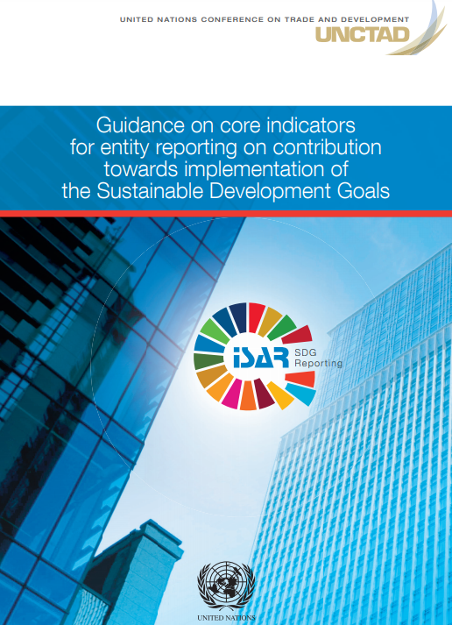

Guidance on Core Indicators (GCI)
In 2016, UNCTAD launched its initiative on selecting a limited number of core SDG indicators to facilitate companies reporting on their contribution to the SDG agenda with a view to improve comparability of sustainability/SDG reporting and its alignment with the SDG macro indicators.
Notes:
The Core indicators are at the intersection of micro- and macro-level trends and needs
Consistent with the SDGs monitoring framework and aligned with countries needs on monitoring the attainment of the SDG agenda
A set of global indicators focused on measurable outcomes that companies are providing in their reports and that can inform country reporting on the progress of the private sector on SDGs.

Slide 15

The objective of the GCI guidance
to provide practical information on how these indicators could be measured in a consistent manner and in alignment with countries’ needs on monitoring the attainment of the SDG agenda.
to assist governments to assess the private sector contribution to the SDG implementation and to enable them to report on SDG indicator 12.6.1.
to assist entities to provide baseline data on sustainability issues in a consistent and comparable manner that would meet common needs of many different stakeholders of the SDG agenda

Slide 16
UNCTAD’s approach
Logical framework:
Example:
17 Sustainable Development Goals
Framework of SDG targets and indicators
Enterprise indicators
SDG 7: Affordable and Clean Energy
7.2.1: Renewable energy share in the total final energy consumption
B.5.1: Renewable energy as a percentage of total energy consumption during the reporting period
Notes:
The Guidance provides practical information on how these core indicators could be measured in a consistent manner and in alignment with countries’ needs on monitoring the attainment of the SDG Agenda.
It is intended to serve as a tool to assist governments to assess the private sector contribution to the SDG implementation and to enable them to report on SDG indicator 12.6.1.

Slide 17
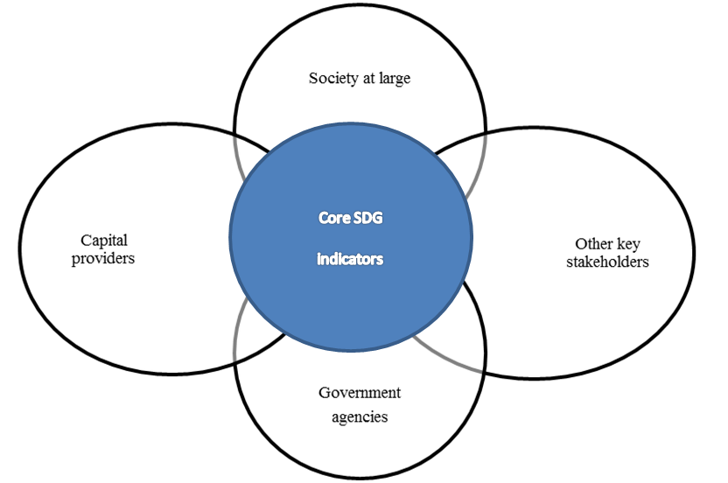
Key users of the core SDG indicators by entities

Slide 18




Underlying principles on core SDG indicators selection and reporting
2.1 Key methodological points
2.2. Selection criteria
2.3 Reporting principles
2.4 Underlying accounting data
Limited number of core SDG indicators have been identified, based on key reporting principles, selection criteria, main reporting frameworks and companies reporting practices.

Slide 19
Key methodological points
Simplicity: user-friendly tool for preparers of information
Baseline approach: selected core indicators are common to any business
Emphasis on quantitative indicators: although importance of narrative disclosures is also acknowledged
Alignment between the micro- and macro-level indicators: each entity reporting indicator (micro level) refers to the most relevant SDG indicator (macro level)

Slide 20

Selection criteria
Based on existing key initiatives or reporting frameworks and/or should be found in corporate reports;
Universality (applicable to all reporting entities);
Comparability across industries and regions;
Ability to address issues over which an entity has control and for which it gathers data (incremental approach);
Ability to facilitate convergence of financial and non-financial reporting principles and data;
Capability of consistent measurement; and
Suitability for consolidated reporting and legal entity reporting.

Slide 21
Reporting Principle
Universality vs Materiality: in the SDG context materiality has a new broader dimension.
Clarity of reporting boundaries: important to disclose basis of determining boundaries to address consistency with international financial reporting standards.
Consistency in measurement methodology and data comparability: to drive comparability across entities, time and geography.
Reporting period: reference to the same reporting period both in financial and non-financial reporting.

Slide 22




Core SDG Indicators
Four areas
Economic
Social
Institutional
Environmental
Notes:
The Guidance on Core indicators for entity reporting on the contribution towards the attainment of the Sustainable Development Goals is founded on elaborations on the SDG reporting issue over the last three years during the ISAR annual sessions and at the intersessional forums, including Consultative Group meetings convened by UNCTAD from 2016 to 2018.

Slide 23
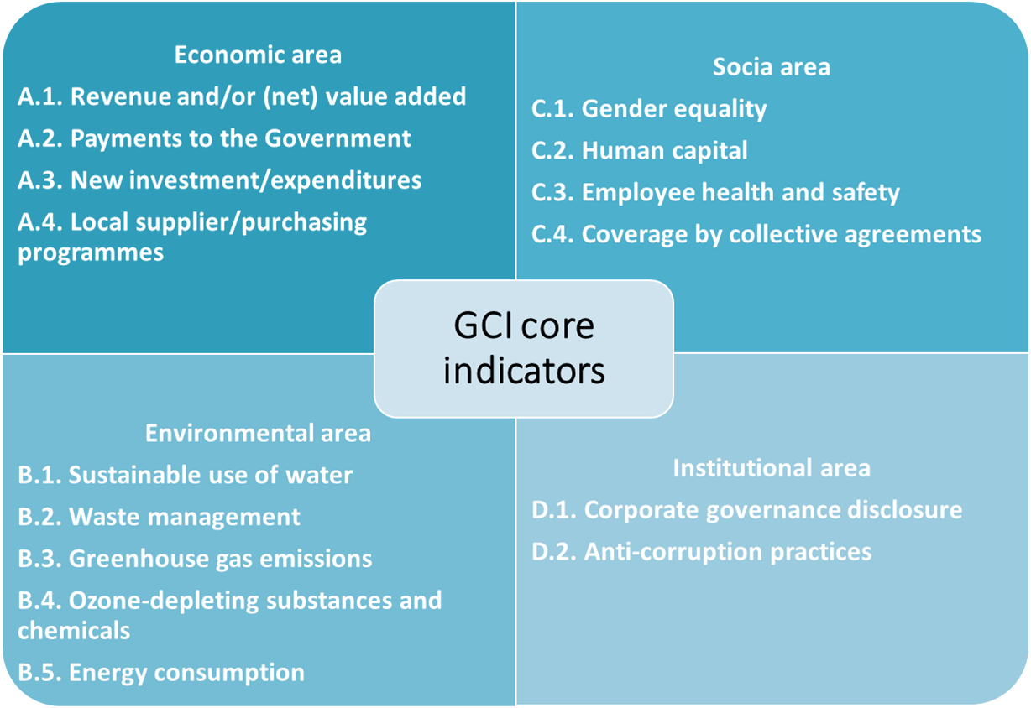
4. Areas of Core Indicators

Slide 24
GCI Practical Implementation: Case Studies
Case Studies
Objective of case studies: examine the relevance and applicability of the GCI and to validate suggested approach and accounting data availability.
20+ case studies conducted
In different geographical areas: countries with various levels of economic development
In a great range of industries
With companies of different sizes including SMEs
Key finding: most of the core indicators could be reported.

Slide 25
Companies participating at case studies
Case Studies
Represented industries:
oil and gas
hospitality
garment
energy
healthcare
mining and metallurgical
commodity paper products
academia
apparel retailer
cutting tools
cosmetics
telecommunication
chemical manufacturing
conglomerate
agriculture
engineering
paints and coating solutions
textiles

Slide 26
Companies participating at case studies
Case Studies
Represented countries:
Colombia
Guatemala
Denmark
Russia
Ukraine
South Africa
Egypt
Poland
Italy
Kenya
China
Saudi Arabia
USA
Tanzania
India
Netherlands
Turkey
An overview of the implementation of the Guidance in several companies was conducted in Egypt
Several more case studies are in progress

Slide 27
Most companies were able to provide data on most of the core indicators
Most companies were able to provide data on most core indicators
There was no single indicator that was not reported on by all companies participating in the pilot tests
Companies already using frameworks for sustainability reporting faced fewer challenges in reporting on the core indicators

Slide 28
Significant improvement in the number of UNCTAD core indicators disclosed by companies in sustainability reports
Findings of the Case Studies

Slide 29
Reasons for non-disclosure
Findings of the Case Studies
Several cases studies raised issues relating to
Lack of regulation requiring environmental, social and governance/SDG reporting
Lack of coordination among different authorities in charge, including coordination between accounting standards and requirements in the area of environmental, social and governance and SDG reporting
Existence of several entities in charge of different type of companies

Slide 30
SMEs
Findings of the Case Studies
Applicability of core indicators
SMEs provide high disclosures in the economic area
Good disclosure in social area
The most challenging areas are the institutional and environmental areas.
In many instances, the company is already providing qualitative information and is planning to provide quantitative disclosures in line with the guidance on core indicators
Share of difficult to report or not reported indicators by area

Slide 31
Case studies Outcome
Challenges identified include the need for:
Consistent measurement and comparability of reported indicators.
Further coordination and cooperation at the national level of key stakeholders in the public and private sectors.
Further efforts on building national institutional and regulatory mechanisms on SDG reporting.
Capacity-building at all levels to facilitate progress.
Notes:
Further efforts on building national institutional and regulatory mechanisms on SDG reporting to ensure its quality, comparability, reliability and consistency with accounting and financial reporting.

Slide 32
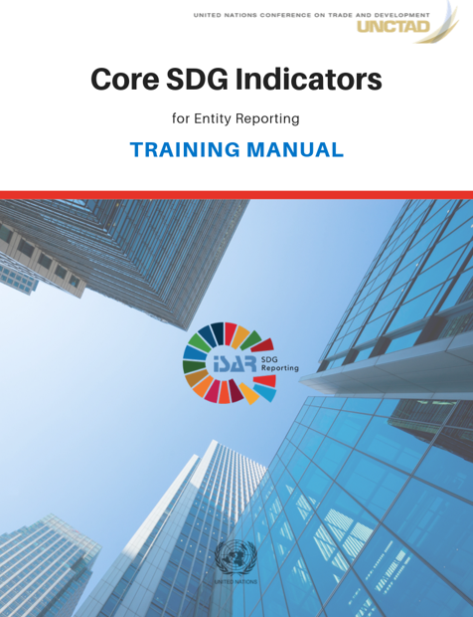
Training manual
For further details please consult Training Manual: more technical guidance on improved the data availability.
The manual includes:
Definition
Measurement methodology (with illustrative, numerical examples)
Potential sources of information
Examples of how these indicators have been already incorporated in the reporting practices of companies around the world
Self-assessment questions with solutions

Slide 33
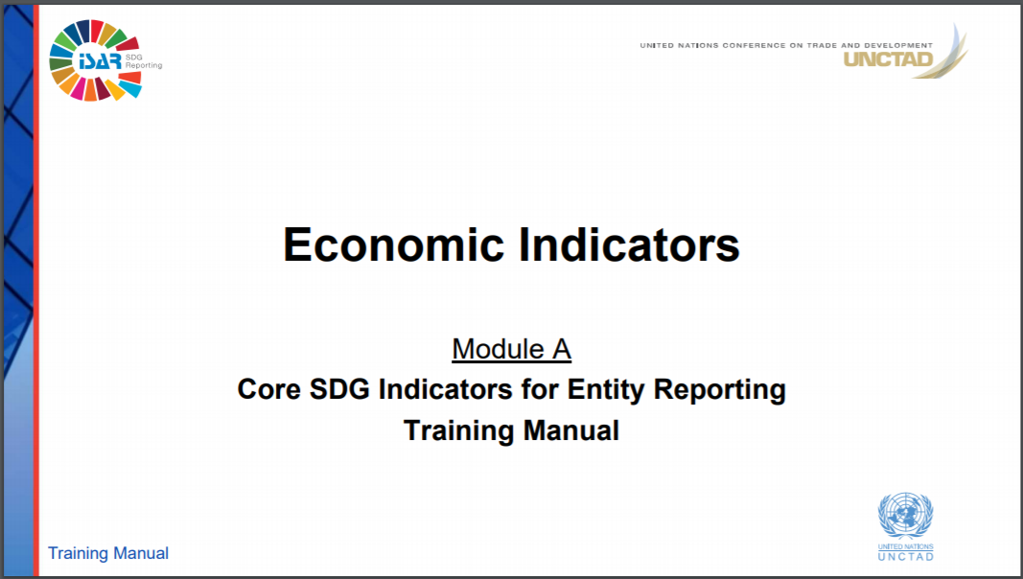
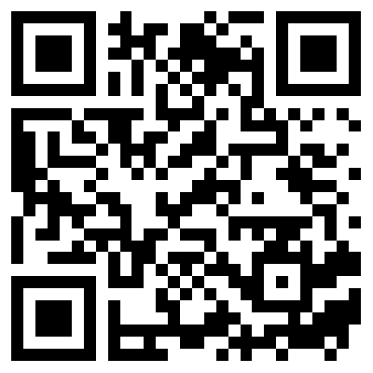
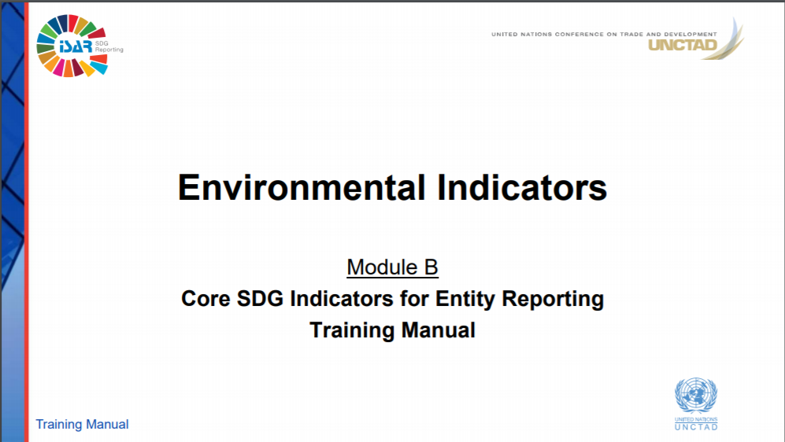
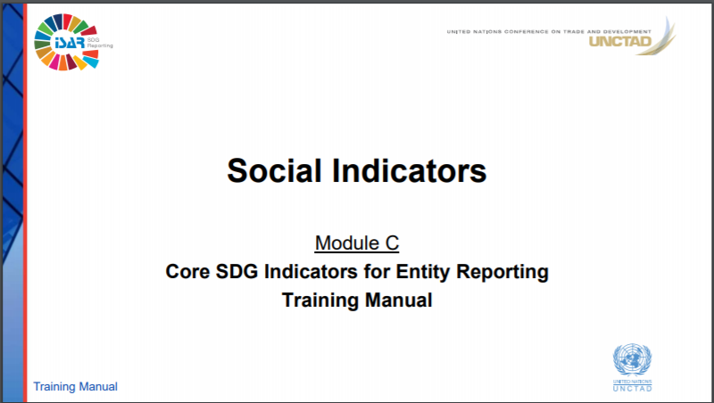
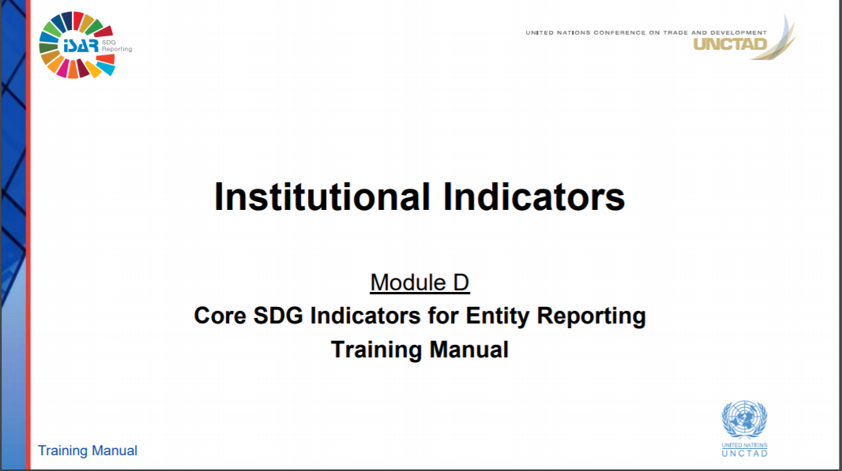
Training Slides and E-learning prepared
Training Manual
To facilitate the technical capacity building and enhance implementation of the core indicators through increased accessibility, UNCTAD has prepared training slides of the manual
E-learning materials are in development
https://isar.unctad.org/training-materials/

Slide 34
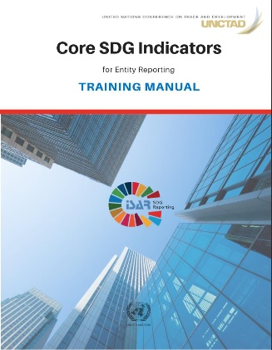
Supporting Materials
Training Manual
https://isar.unctad.org/training-materials/
GCI as good start towards producing comparable data
Technical guidance to improve data availability
GCI & Case Studies
Capacity-building required
Training Manual
4 chapters with a list of selected references
Available in English and Spanish
E-learning Materials
Definition
Measurement methodology
Examples
Potential sources of information
Self-assessment questions with solutions.
Notes:
Consistent measurement and comparability of reported indicators remain a challenge
Need for further coordination and cooperation at a national level of key stakeholders in the public and private sectors
Further efforts on
Building national institutional and regulatory mechanisms on SDG reporting to ensure its quality, comparability, reliability and consistency with accounting and financial reporting
Capacity building at all levels to facilitate progress
Recommended that case study repeated in the future to measure the degree of change in the level of SDGs disclosure over time
The case studies process reflected that when further technical guidance was provided, data availability for the core indicators at a company level was improved. Therefore, building technical capacity and providing guidance could be important means for further implementation of core indicators for a baseline SDG reporting by companies.

Slide 35
Next Steps: Final Project Phase
Capacity Building activities for large and listed companies (TBD July)
Conduct Advisory mission to implement the last phase of the project and present the plan of actions
Organize a Regional Workshop to share experience and the best practice with the neighboring countries (to be held in Cameroon in November 2021).

Slide 36



Project Chronogram
Kick off Meeting
21 Nov’19
Interim Progress Meeting
9 June’20
National Workshop
28-30 Oct’20
Action Plan Present
TBD
GCI SME Workshop
(12-13 July’21)
Advisory Mission TBD
Additional
capacity-building activities
GCI Workshop
(TBD)
12.6.1 Workshop (TBD)
Regional Workshop
Nov 2021

Slide 37
Please complete the Feedback Form
https://docs.google.com/forms/d/1Gko1q_SC3H6DqgM6hm321GpjFl1jKRwUU_vyMLNvC8s/edit
Link is also available in the Chat Box

Slide 38
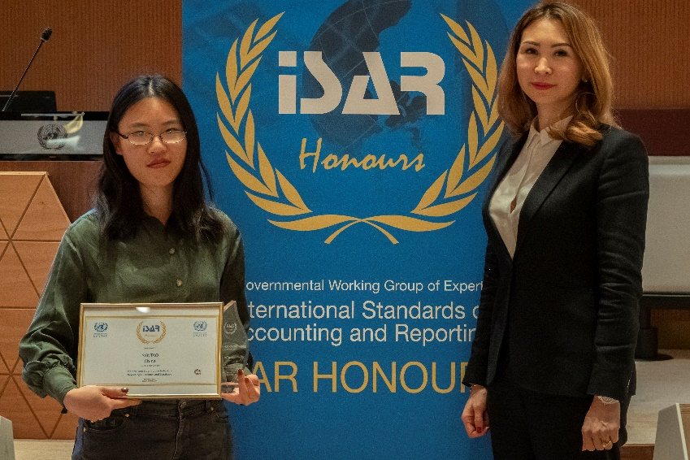

ISAR Honours Call 2021
Objective is to raise awareness and facilitate dissemination of national and international best practices on sustainability and SDG reporting by companies
Nominees in the area of sustainability/ESG/SDG:
Dissemination of good reporting practices
Developing/implementing guidelines for reporting frameworks
Developing/implementing index and benchmark mechanisms
Setting up knowledge hubs/ platforms/ data repositories
Developing or implementing training initiatives etc.
SAMCODES received ISAR Honours
for ESG Guidance for Mining, Oil & Gas in 2019
SUBMIT YOU APPLICATION!
https://isar.unctad.org/
Video

